Slide 1

OKCupid Project:
Date-A-Scientist
Machine learning techniques to predict the zodiac signs of OKCupid users based on their profile features

Slide 2
Project Overview and Focus
Agenda
1
Exploring the Data
2
Preprocessing the Data
3
Building the Models
4
Conclusion
5

Slide 3

Project Overview and Focus
This project analyzes data from OKCupid, an app that focuses on using multiple choice and short answers to match users. The purpose of this project is to practice formulating questions and implementing machine learning techniques to answer those questions.
This project focuses on using machine learning techniques to predict the zodiac signs of OKCupid users based on their profile features. By exploring various classification algorithms and evaluating their performance, we aim to determine whether user characteristics can meaningfully predict astrological sign. The analysis includes data cleaning, feature engineering, model training, and interpretation of results to assess the relationship between user attributes and zodiac signs.

Slide 4
Exploring the Data

Slide 5
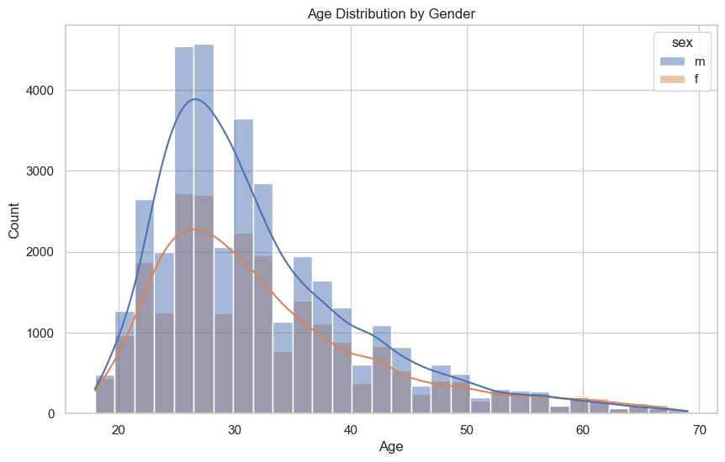
Age and Gender
The majority of OKCupid users are in their late 20s to early 30s.
The mean age is approximately 32.3 years, and the median is 30.
There are more men (35,825) than women (24,116) in the dataset.
The correlation between age and sex is very weak (0.042), suggesting that age and gender are nearly independent in this dataset.

Slide 6
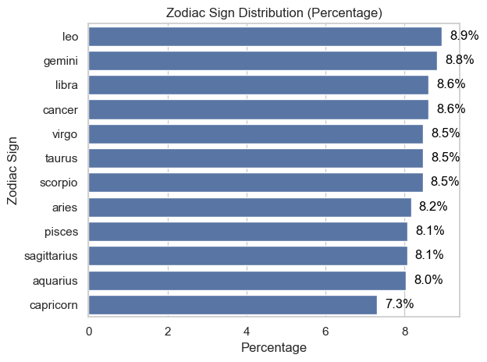
Sign
Key Insights:
All twelve zodiac signs are represented in the dataset, with some variation in their frequencies.
The distribution is relatively even, though certain signs may be slightly more or less common.
This evenness suggests that users' zodiac signs are not heavily skewed or underrepresented, providing a balanced target variable for subsequent modeling.
Understanding the distribution of zodiac signs is important for interpreting model results and ensuring that no class imbalance will bias the predictive analysis.
This bar plot above shows the percentage distribution of each zodiac sign among OKCupid users.
Each bar represents a zodiac sign, and the length of the bar indicates its proportion in the dataset.

Slide 7
Preprocessing
the Data

Slide 8
Sign to Sign Cleaned
Religion to Religion Cleaned
Initially, the dataset contained 48 unique signs, making it essential to clean the sign data and create a new column for the cleaned sign data that aligns with the standard set of 12 zodiac signs.
The dataset initially included 45 unique religions, necessitating the cleaning of this data. After cleaning, a new column was created for the refined religion data, resulting in 9 distinct categories.

Slide 9
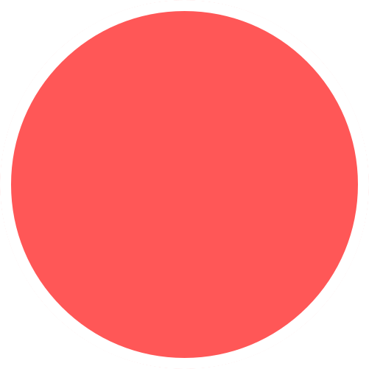
Preprocessing Data Steps
1
Column selection and subsetting
2
One-hot encoding
3
Verification of encoding
4
Target distribution check
5
Train/validation split

Slide 10
Building the Models

Slide 11
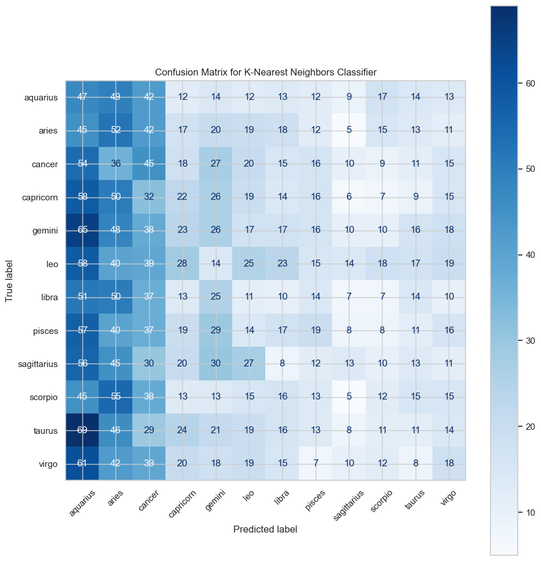
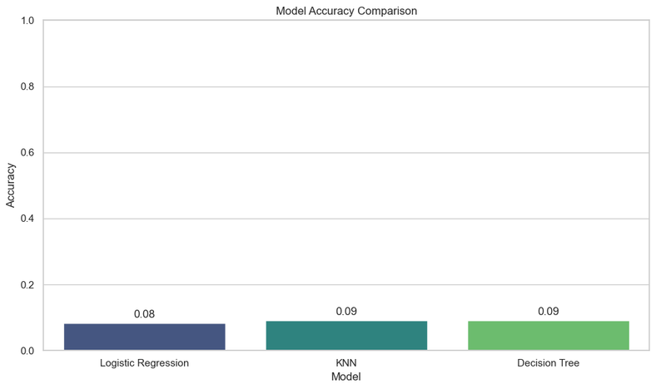
The Models
The confusion matrix shows that the KNN classifier struggles with zodiac sign predictions, with scattered predictions and few strong diagonals, indicating frequent misclassification. The low accuracy (~9.1%) is barely above random guessing (8.3% for 12 classes), suggesting the features lack predictive power.
The chart above compares the accuracy of the three machine learning models—Logistic Regression, K-Nearest Neighbors (KNN), and Decision Tree—on the zodiac sign prediction task.

Slide 12
Conclusion
Our analysis examined whether machine learning models could predict OKCupid users' zodiac signs based on profile features like body type, diet, orientation, pets, religion, sex, and job. We used various classification algorithms, including Logistic Regression, K-Nearest Neighbors, and Decision Trees, with one-hot encoded features and standardized data.
Key Findings:
All models had low accuracy (8–9%), slightly better than random guessing (~8.3% for 12 zodiac signs).
Precision, recall, and F1-scores were low across all zodiac signs, indicating poor model performance.
Confusion matrices showed scattered predictions with no strong patterns.
Feature selection and preprocessing did not enhance predictive power.
Interpretation:
There is minimal to no meaningful link between the profile features and zodiac signs, suggesting these characteristics don't encode zodiac signs in OKCupid profiles.

